Slide 1
F.P. Operations
Conceptual View
  First compute exact result
  Make it fit into desired precision
    Possibly overflow if exponent too large
    Possibly round to fit into frac
Rounding Modes (illustrate with $ rounding)
$1.40 $1.60 $1.50 $2.50 –$1.50
  Zero $1 $1 $1 $2 –$1
  Round down (-∞) $1 $1 $1 $2 –$2
  Round up (+∞) $2 $2 $2 $3 –$1
  Nearest Even (default) $1 $2 $2 $2 –$2
Note:
1. Round down: rounded result is close to but no greater than true result.
2. Round up: rounded result is close to but no less than true result.

Slide 2
Closer Look at Round-Even
Default Rounding Mode
  Hard to get any other kind without dropping into assembly
  All others are statistically biased
    Sum of set of positive numbers will consistently be over- or under- estimated
Applying to Other Decimal Places / Bit Positions
  When exactly halfway between two possible values
    Round so that least significant digit is even
  E.g., round to nearest hundredth
    1.2349999 1.23 (Less than half way)
    1.2350001 1.24 (Greater than half way)
    1.2350000 1.24 (Half way—round up)
    1.2450000 1.24 (Half way—round down)

Slide 3
Rounding Binary Numbers
Binary Fractional Numbers
  “Even” when least significant bit is 0
  Half way when bits to right of rounding position = 100…₂
Examples
  Round to nearest 1/4 (2 bits right of binary point)
  Value Binary Rounded Action Rounded Value
  2 3/32 10.00011₂ 10.00₂ (<1/2—down) 2
  2 3/16 10.00110₂ 10.01₂ (>1/2—up) 2 1/4
  2 7/8 10.11100₂ 11.00₂ (1/2—up) 3
  2 5/8 10.10100₂ 10.10₂ (1/2—down) 2 1/2

Slide 4
F.P. Multiplication
Operands
  (–1)^{s1} M1 2^{E1 *} (–1)^{s2} M2 2^{E2}
Exact Result
  (–1)^{s} M 2E
  Sign s: s1 ^ s2
  Significand M: M1 * M2
  Exponent E: E1 + E2
Fixing
  If M ≥ 2, shift M right, increment E
  If E out of range, overflow
  Round M to fit frac precision
Implementation
  Biggest chore is multiplying significands

Slide 5
Properties of F.P. Mult
Compare to Commutative Ring
  Closed under multiplication? YES
    But may generate infinity or NaN
  Multiplication Commutative? YES
  Multiplication is Associative? NO
    Possibility of overflow, inexactness of rounding
  1 is multiplicative identity? YES
  Multiplication distributes over addition? NO
    Possibility of overflow, inexactness of rounding
Monotonicity
  a ≥ b & c ≥ 0 ⇒ a *c ≥ b *c? ALMOST
    Except for infinities & NaNs

Slide 6
F.P. Addition
Operands
  (–1)^{s1} M1 2^{E1}
  (–1)^{s2} M2 2^{E2}
  Assume E1 > E2
Exact Result
  (–1)^{s} M 2E
  Sign s, significand M:
    Result of signed align & add
  Exponent E: E1
Fixing
  If M ≥ 2, shift M right, increment E
  if M < 1, shift M left k positions, decrement E by k
  Overflow if E out of range
  Round M to fit frac precision
E1–E2
  (–1)^{s1} M1
+
  (–1)^{s2} M2
  (–1)^{s} M

Slide 7
Adding FP Numbers
1 HB
0 1000 0101 .0110 … 0000
2 ⁺⁶ * 1.375 = + 88.0
+
1 HB
0 0111 1110 .1010 … 0000
2 ⁻¹ * 1.625 = + .8125
1 HB
0 0111 1110 .1010 … 0000
Shift mantissa of smaller number right 7 places, note hidden bit
0 1000 0101 .0000 0011 0100 … 0000
0
+
0
1 HB
0
0 1000 0101 .0110 … 0000
0
1 HB
0
0 1000 0101 .0110 0011 0100 … 0000
0
0
Result is normalized as is:
1 + 1/4 + 1/8 + 1/128 + 1/256 + 1/1024
2 ⁺⁶ * 1 .3876953 = + 88.8125

Slide 8
Adding FP Numbers (cont’d)
1 HB
0 1000 0101 .1110 … 0000
2 ⁺⁶ * 1 .875 = + 120.0
+
1 HB
0 1000 0010 .1011 … 0000
2 ⁺³ * 1.6875 = + 13.5
1 HB
0 1000 0010 .1011 … 0000
Shift mantissa of smaller number right 3 places, note hidden bit
0 1000 0101 .0011 0110 … 0000
0
+
0
1 HB
0
0 1000 0101 .1110 … 0000
10 HB + Carry Out
0 1000 0101 .0001 0110 … 0000
Normalize result
1 HB
0 1000 0110 .0000 10110 … 0000
0
2 ⁺⁷ * 1 .04296875 = + 133.5

Slide 9
Properties of F.P. Addition
Compare to those of Abelian Group
  Closed under addition? YES
    But may generate infinity or NaN
  Commutative? YES
  Associative? NO
    Overflow and inexactness of rounding
  0 is additive identity? YES
  Every element has additive inverse ALMOST
    Except for infinities & NaNs
Monotonicity
  a ≥ b ⇒ a+c ≥ b+c? ALMOST
    Except for infinities & NaNs

Slide 10
Floating Point in C
C Guarantees Two Levels
  float single precision
  double double precision
Conversions
  Casting between int, float, and double changes numeric values
  Double or float to int
    Truncates fractional part
    Like rounding toward zero
    Not defined when out of range
      Generally saturates to TMin or TMax
  int to double
    Exact conversion, as long as int has ≤ 53 bit word size
  int to float
    Will round according to rounding mode

Slide 11
F.P. Puzzles
int x = …;
float f = …;
double d = …;
Assume neither
d nor f is NaN
x == (int)(float) x
x == (int)(double) x
f == (float)(double) f
d == (float) d
f == -(-f)
2/3 == 2/3.0
d < 0.0 ⇒ ((d*2) < 0.0)
d > f ⇒ -f > -d
d * d >= 0.0
(d+f)-d == f

Slide 12
F.P. Puzzles (Practice Prob 2.54)
int x = …;
float f = …;
double d = …;
Assume neither
d nor f is NaN
x == (int)(float) x False
x == (int)(double) x True
f == (float)(double) f True
d == (float) d False
f == -(-f) True
2/3 == 2/3.0 False
d < 0.0 ⇒ ((d*2) < 0.0) T
d > f ⇒ -f > -d T
d * d >= 0.0 T
(d+f)-d == f F (not associative)

Slide 13
Summary
IEEE Floating Point Has Clear Mathematical Properties
  Represents numbers of form M X 2E
  Can reason about operations independent of implementation
    As if computed with perfect precision and then rounded
  Not the same as real arithmetic
    Violates associativity/distributivity
    Makes life difficult for compilers & serious numerical applications programmers

Slide 14
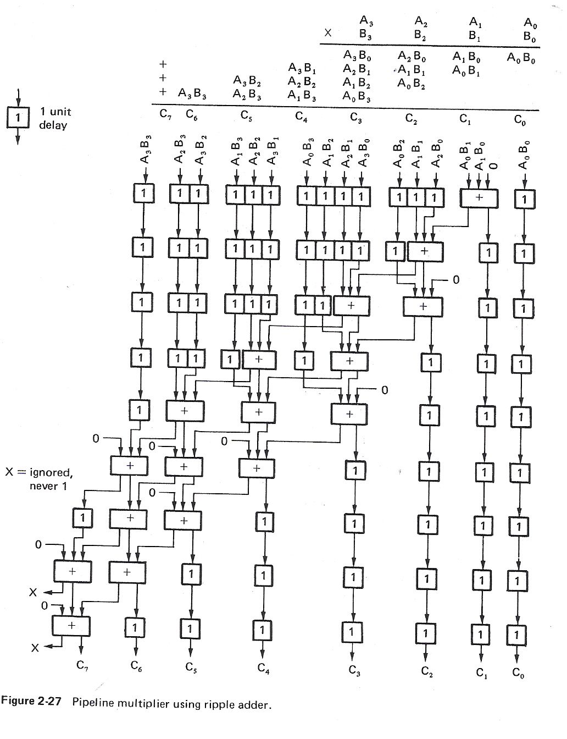
Linear Pipelining
Additional hardware to speed up repetition of identical function (add, multiply, etc.)

Slide 15
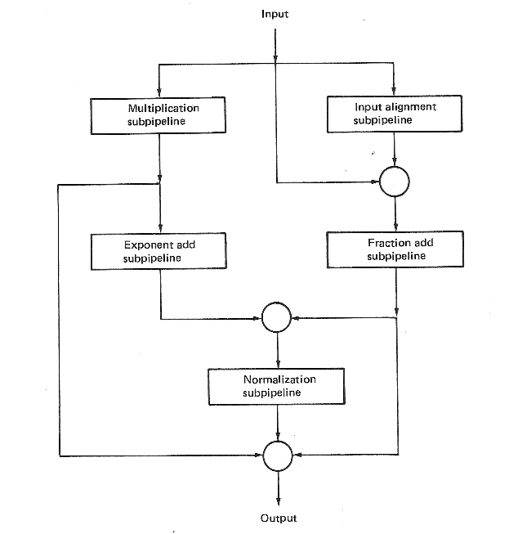
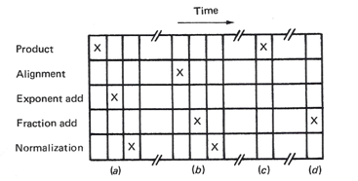
Nonlinear Pipelining – F.P.
A: floating-pt multiply
B: floating-pt add
C: fixed-pt multiply
D: fixed-pt add

